Slide 1
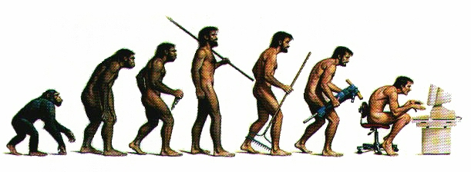


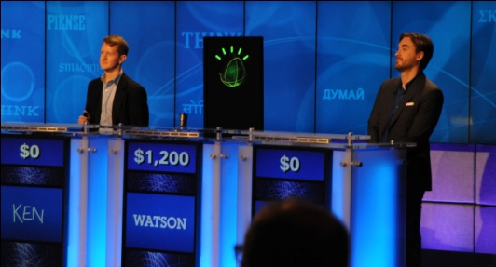

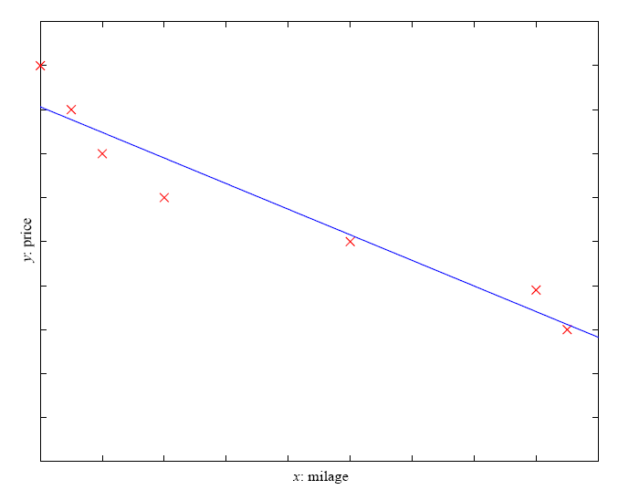
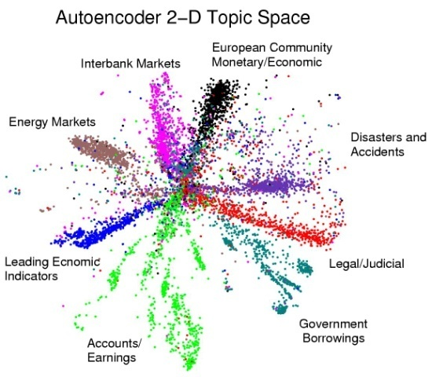
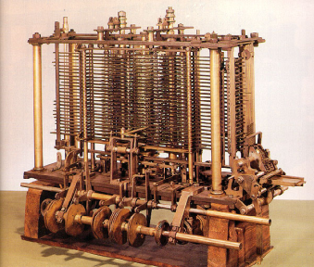
Machine Learning
CS 165B
Spring 2012

Slide 2
Course outline
Introduction (Ch. 1)
Concept learning (Ch. 2)
Decision trees (Ch. 3)
Ensemble learning
Neural Networks (Ch. 4)
…

Slide 3
Schedule
Homework 2 on decision trees will be handed out Thursday 4/19; due Wednesday 5/2
Project choices by Friday 4/20
  Topic of discussion section

Slide 4
Projects
Projects proposals are due by Friday 4/20.
2-person teams
If you want to define your own project:
  Submit a 1-page proposal with references and ideas
  Needs to have a significant Machine Learning component
  You may do experimental work, theoretical work, a combination of both or a critical survey of results in some specialized topic.
Originality is not mandatory but is encouraged.
Try to make it interesting!

Slide 5
Rationale for Ensemble Learning
No Free Lunch thm: There is no algorithm that is always the most accurate
Generate a group of base-learners which when combined have higher accuracy
Different learners use different
  Algorithms
  Parameters
  Representations (Modalities)
  Training sets
  Subproblems

Slide 6
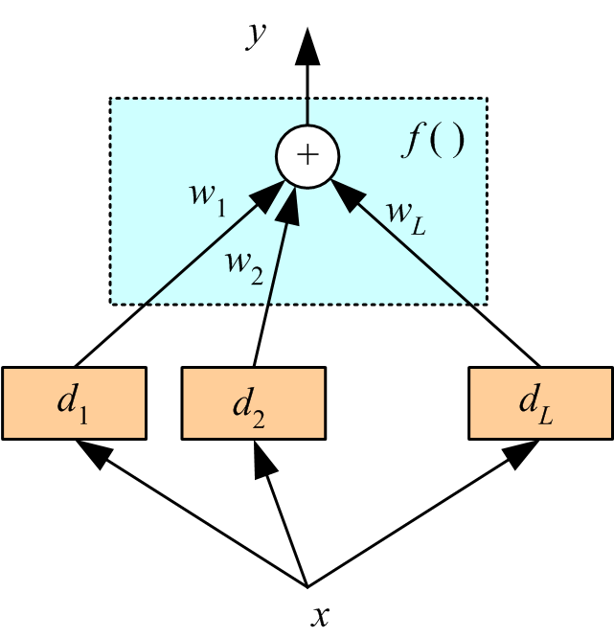
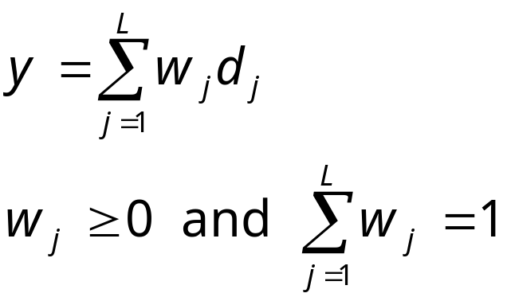
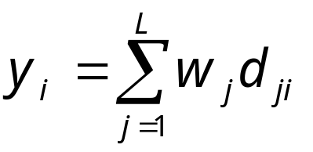
Voting
Linear combination
Classification

Slide 7
Bagging (Bootstrap aggregating)
Take M bootstrap samples (with replacement)
Train M different classifiers on these bootstrap samples
For a new query, let all classifiers predict and take an average (or majority vote)
If the classifiers make independent errors, then their ensemble can improve performance.
Stated differently: the variance in the prediction is reduced (we don’t suffer from the random errors that a single classifier is bound to make).

Slide 8
Boosting
Train classifiers (e.g. decision trees) in a sequence.
A new classifier should focus on those cases which were incorrectly classified in the last round.
Combine the classifiers by letting them vote on the final prediction (like bagging).
Each classifier is “weak” but the ensemble is “strong.”
AdaBoost is a specific boosting method.

Slide 9
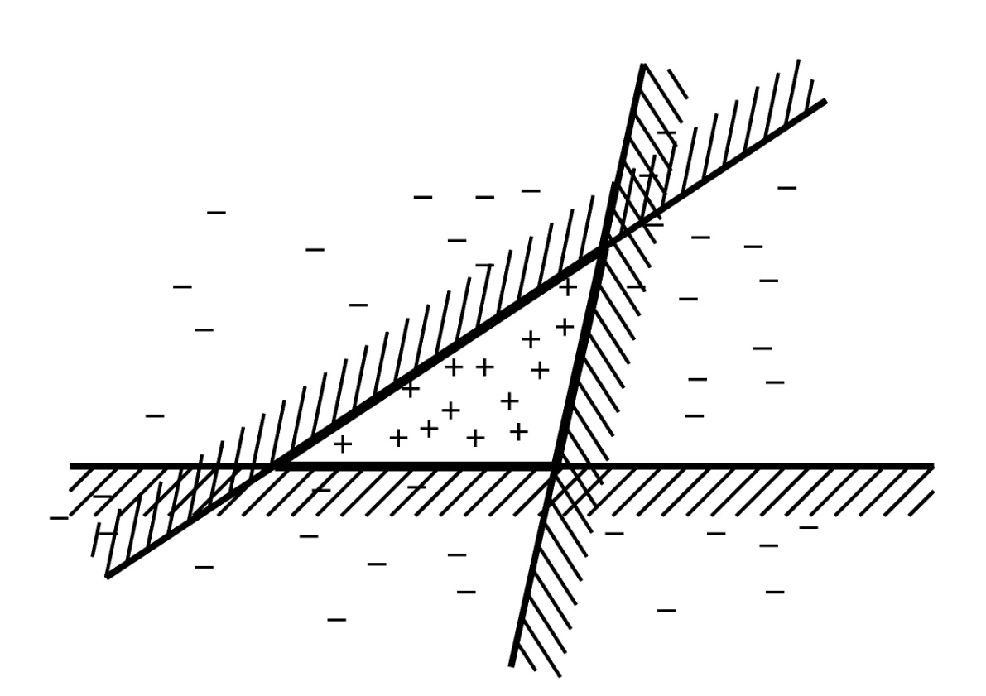
Example
This line is one simple classifier saying that
everything to the left + and everything to the right
is -

Slide 10
Boosting Intuition
We adaptively weigh each data case.
Data cases which are wrongly classified get high weight (the algorithm will focus on them)
Each boosting round learns a new (simple) classifier on the weighed dataset.
These classifiers are weighed to combine them into a single powerful classifier.
Classifiers that that obtain low training error rate have high weight.
We stop by using monitoring a hold out set (cross-validation).

Slide 11
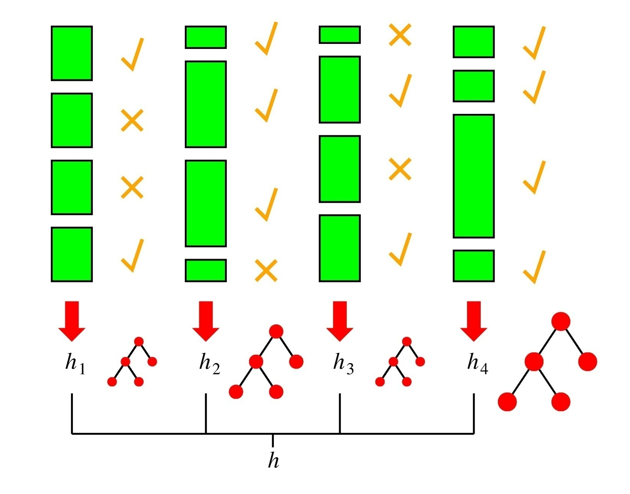
Boosting in a Picture
boosting rounds
training cases
Correctly
classified
This example
has a large weight
in this round
This DT has
a strong vote.

Slide 12
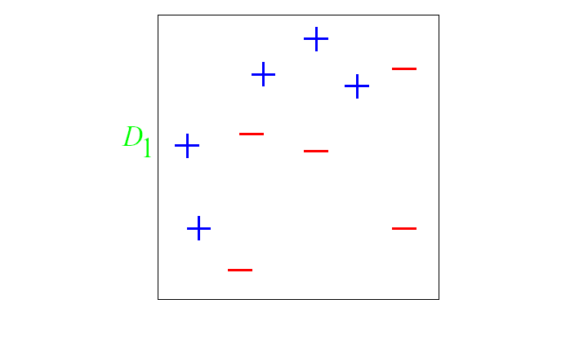
And in animation
Original training set: equal weights to all training samples
Taken from “A Tutorial on Boosting” by Yoav Freund and Rob Schapire

Slide 13
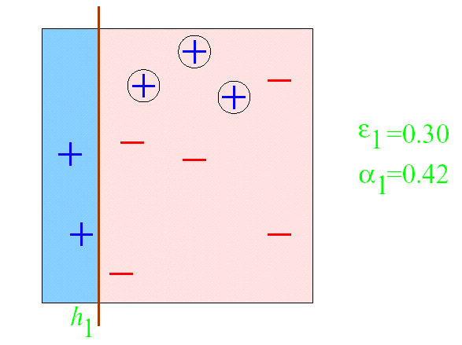
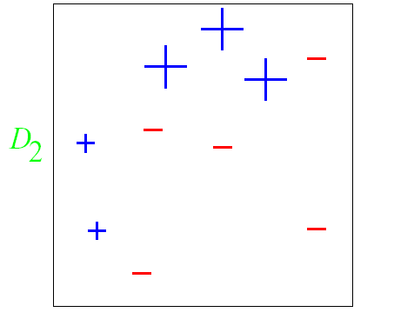
AdaBoost example
ε = error rate of classifier
α = weight of classifier
ROUND 1

Slide 14
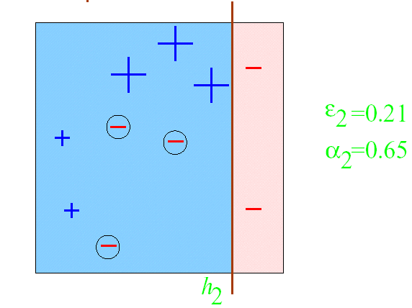
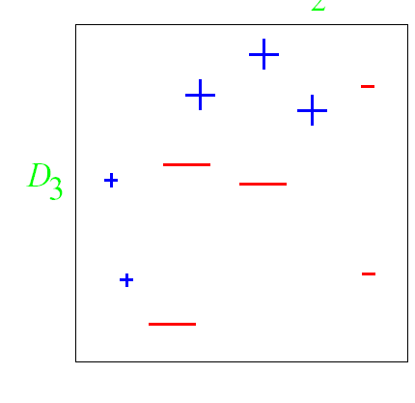
AdaBoost example
ROUND 2

Slide 15
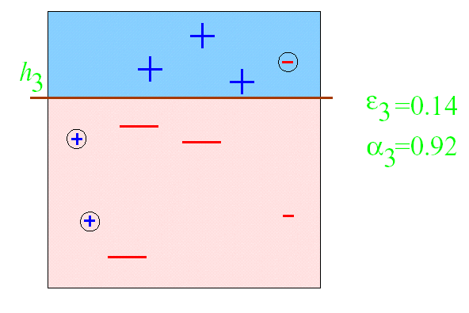
AdaBoost example
ROUND 3

Slide 16
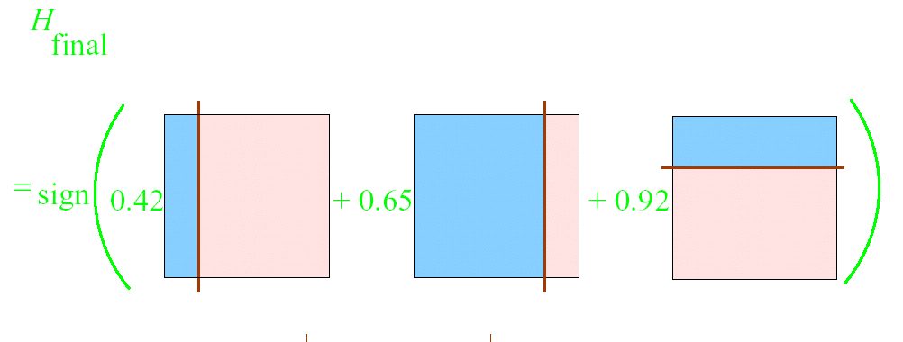
AdaBoost example

Slide 17
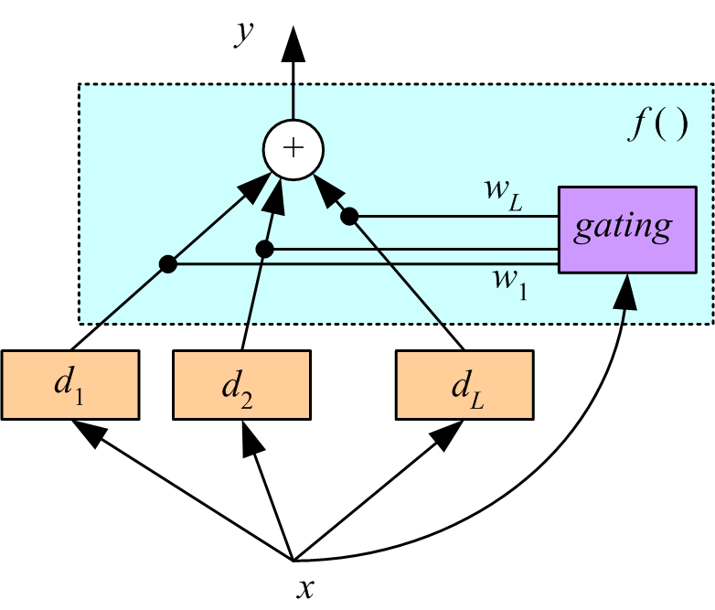
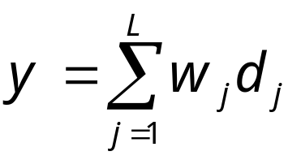
Mixture of experts
Voting where weights are input-dependent (gating)
Different input regions convered by different learners (Jacobs et al., 1991)
Gating decides which expert to use
Need to learn the individual experts as
well as the gating functions w_{i}(x):
Σw_{j}(x) = 1, for all x

Slide 18
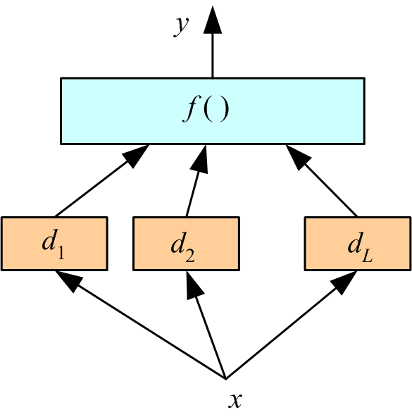
Stacking
Combiner f () is another learner (Wolpert, 1992)

Slide 19
Random Forest
Ensemble consisting of a bagging of un-pruned
decision tree learners with a randomized selection of
features at each split.
Grow many trees on datasets sampled from the original dataset with replacement (a bootstrap sample).
  Draw K bootstrap samples of a fixed size
  Grow a DT, randomly sampling a few attributes/dimensions to split on at each internal node
Average the predictions of the trees for a new query (or take majority vote)
Random Forests are state of the art classifiers!

